Slide 1
Coaster Countdown!
Sensation Park Entertainment Group

Slide 2
Launch Time!
Sensation Park Entertainment Group will introduce several new roller coasters next year at several parks. The attractions are named Intensity, Hang Time, and Last Chance.

Slide 3
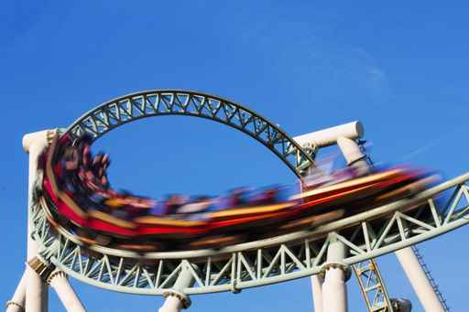
New Coasters for 2019
Intensity
2,933 foot steel coaster
Playa Vista Park
Hang Time
7,438 foot steel coaster
Edmonton Park
Last Chance
4,564 foot steel coaster
Beech Springs Park

Slide 4
Let the Fun Begin!

